Slide 1
MALARIA PARASITE DETECTION USING TRANSFER LEARNING
tEAM Kanyaraasi
Amarnadha reddy
Naveen kumar
pradeeth bathina
SHAJAHAN MOHAMMAD

Slide 2
Contents
Introduction
Current Instances
Objective
Data Sets
Proposed Model
Conclusion

Slide 3
Introduction
Malaria is a life-threatening parasitic disease spread by female Anopheles mosquitoes.
It's treatable as well as preventable.
According to the WHO, there are 212 million cases of malaria and 435,000 deaths worldwide.

Slide 4
Current Instances
Requires expertise.
Requires microscopic examination of blood.
Long waiting period of patients.
Gold standard of Malaria diagnosis.
Rapid diagnostic test detecting specific antigens.

Slide 5
Current Instances
The techniques reported in this domain of study focused primarily on hand-crafted features in decision making.
Automatic systems, such as those based on machine learning techniques, were initially investigated to address this issue, as malaria was previously mostly diagnosed in the laboratory, necessitating a great deal of human expertise.
Few malaria detection tools, for example, relied on morphological factors for feature extraction and used SVM and Principal Component Analysis (PCA) for classification.

Slide 6
Objective
Malaria is a parasitic disease spread by Plasmodium parasites that can be fatal. Trained microscopists analyze microscopic blood smear images to detect it.
Our main objective is to develop an automatic accurate and efficient model that can greatly reduce the need for trained personnel for detecting a parasite.
We propose an entirely automated Convolutional Neural Network (CNN)-based model for diagnosing malaria from microscopic blood smear images in this project.
We plan to deploy this proposed model in a Flask-based web application for practical validation of model efficiency.

Slide 7
Data Sets
We plan to train our model to recognize malarial parasite images on test slides with cells.
We plan to use Malaria Cell Images dataset taken from Kaggle. The dataset contains two folders(infected, uninfected) comprising of 27558 images.
Reference : https://www.kaggle.com/iarunava/cell-images-for-detecting-malaria

Slide 8
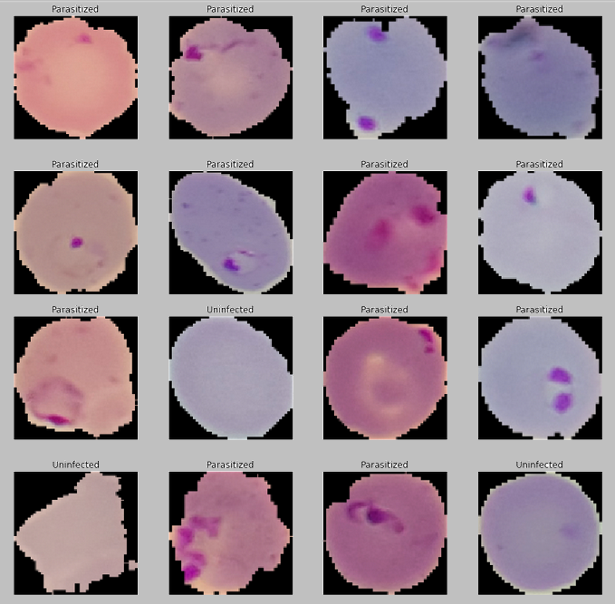
Infected and Uninfected cell images

Slide 9
Proposed Model
The accuracy of the machine learning models used currently is low when compared to the more recently studied deep learning-based techniques.
The application we plan to develop can be easily accessed by public and by simply uploading an image, user can predict whether the disease is affected or not.

Slide 10
Proposed Model
To distinguish infected from uninfected images, we plan to use VGG19 Deep Learning (Convolutional Neural Network) and fine-tuned the model weights across the entire network.
TensorFlow 2.0 will be used to train the model. During the training process, image augmentation and resizing will be done.
We plan to deploy our model into a web application using Flask framework.

Slide 11
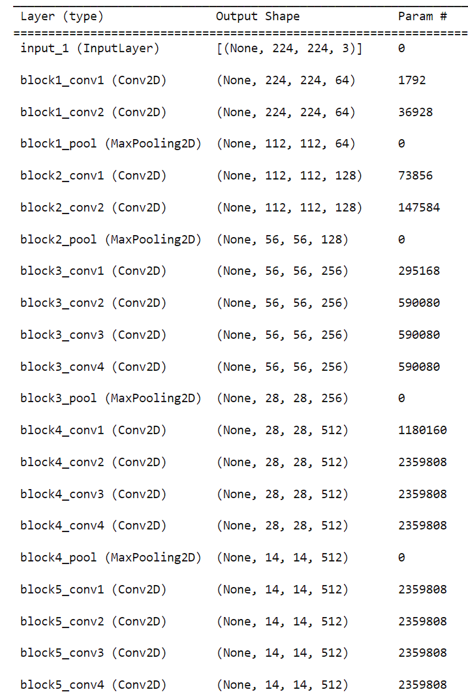
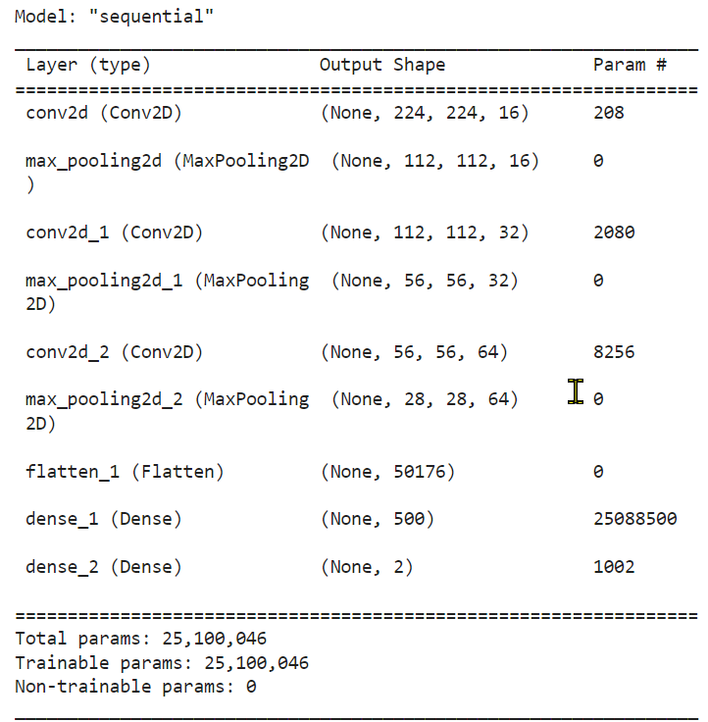
MODEL SUMMARY

Slide 12
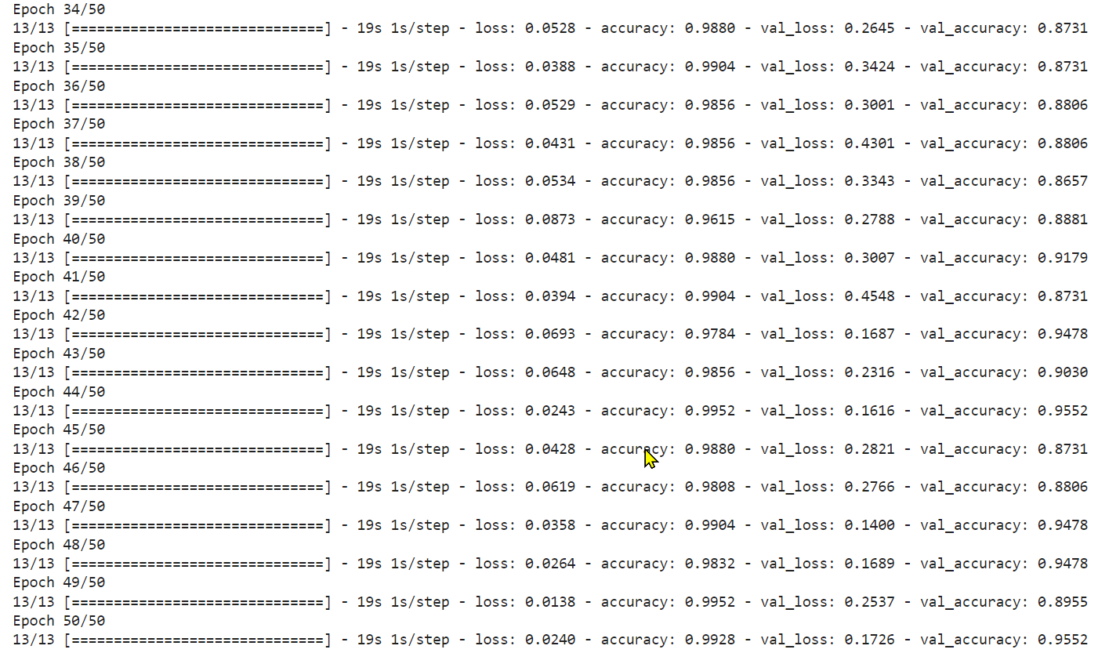
FITTING THE MODEL

Slide 13
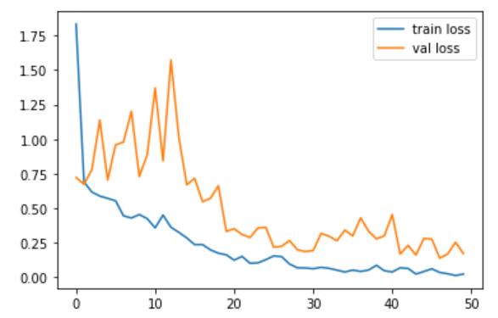
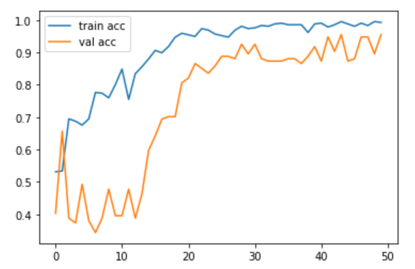
TRAINING AND VALIDATION

Slide 14
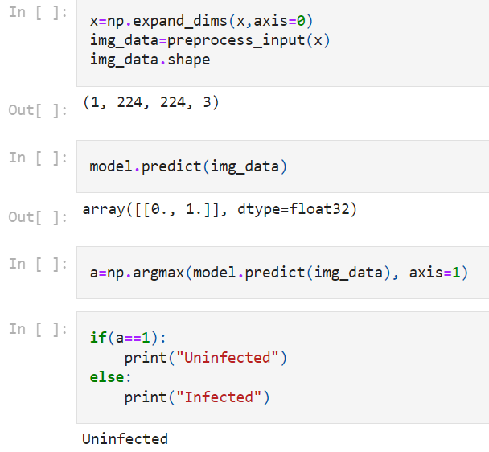
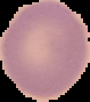
MODEL PREDICTION

Slide 15
FUTURE WORK
Creating a web application using Flask framework.
Comparing VGG19 with different deep learning models like ResNet-50.

